Slide 1



BCSE0004: Operating Systems
Deadlock in Operating Systems
(Lecture:3)
Lecture by Ms. Ambika Gupta

Slide 2
Agenda
The Deadlock Problem
System Model
Deadlock Characterization
Resource Allocation Graph
Methods for Handling Deadlocks
Deadlock Prevention
Deadlock Avoidance
Deadlock Detection
Recovery from Deadlock

Slide 3
What is Banker’s Algorithm in Operating System?
Banker’s Algorithm is a resource allocation and deadlock avoidance algorithm.
In this, as a new process P1 enters, it declares the maximum number of resource it needs.
The system looks at those and checks if allocating those resources to P1 will leave system in safe state or not.
If after allocation, it will be in safe state , the resources are allocated to process P1.
Otherwise, P1 should wait till other process release some resource.

Slide 4
What is Banker’s Algorithm in Operating System?
A state is safe if the system can allocate all resources requested by all processes ( up to their stated maximums ) without entering a deadlock state.

Slide 5
What is Banker’s Algorithm in Operating System?
Available
Each element Available[i] indicates the number of resources of i type available. Denoted by R_{i}
Maximum
Determines maximum demand of each process.
Maximum[i, j] tells the maximum demand an ith process will request of jth type resource.

Slide 6
What is Banker’s Algorithm in Operating System?
Allocation
Defines number of resources of each type currently allocated to each process.
Allocation[i, j] means ith process has current k instance of jth type resource.
Need
Tells about remaining resources type which are required by each process.
Need[i, j] means ith process needs k instance of jth resource type.
Need[i, j] = Maximum[i, j] – Allocation[i, j]

Slide 7
Resource Request Algorithm
Available = Available - Requesti Allocation(i) = Allocation(i) + Request(i) Need(i) = Need(i) - Request(i)
Available = Available – Request(i)
Allocation(i) = Allocation(i) + Request(i)
Need(i) = Need(i) - Request(i)

Slide 8
Safety Algorithm
Available = Available - Requesti Allocation(i) = Allocation(i) + Request(i) Need(i) = Need(i) - Request(i)
Step:1 Let Work and Finish be vectors of length ‘m’ and ‘n’ respectively.
Initialize: Work = Available
Finish[i] = false; for i=1, 2, 3, 4….n
Step:2 Find an i such that both
Finish[i] = false
Needi <= Work
if no such i exists goto step (4)
Step:3 Work = Work + Allocation[i]
Finish[i] = true goto step (2)
Step:4 if Finish [i] = true for all i then the system is in a safe state

Slide 9
Question:
Available = Available - Requesti Allocation(i) = Allocation(i) + Request(i) Need(i) = Need(i) - Request(i)
Considering a system with five processes P0 through P4 and three resources of type A, B, C. Resource type A has 10 instances, B has 5 instances and type C has 7 instances. Suppose at time t0 following snapshot of the system has been taken: (Follow the next slide)

Slide 10
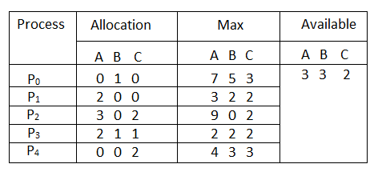
Question:
Available = Available - Requesti Allocation(i) = Allocation(i) + Request(i) Need(i) = Need(i) - Request(i)

Slide 11
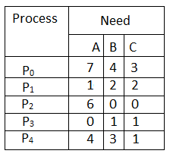
Question:
Available = Available - Requesti Allocation(i) = Allocation(i) + Request(i) Need(i) = Need(i) - Request(i)
Part: 1. What will be the content of the Need matrix?
Need [i, j] = Max [i, j] – Allocation [i, j]
So, the content of Need Matrix is:

Slide 12
Question:
Available = Available - Requesti Allocation(i) = Allocation(i) + Request(i) Need(i) = Need(i) - Request(i)
Part: 2. Is the system in a safe state? If Yes, then what is the safe sequence?
Need [i, j] = Max [i, j] – Allocation [i, j]
So, the content of Need Matrix is:

Slide 14


